Slide 1
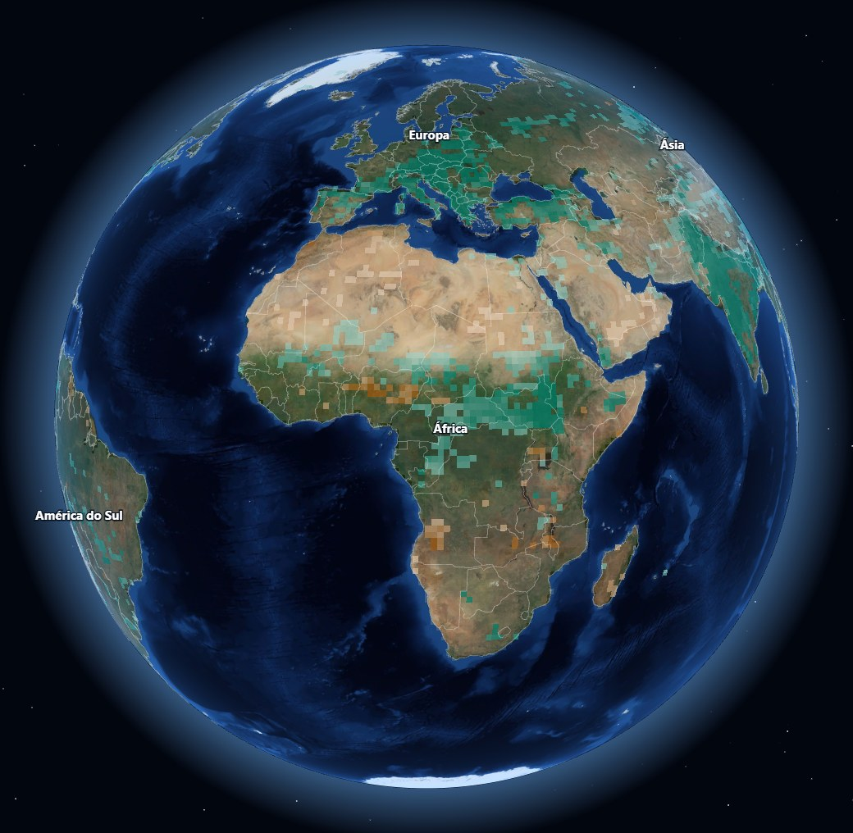
EcoCell Earth Intelligence
NASA SPACE APPS CHALLENGE 2026
What changes on Earth, where, how much – and is it significant?
Team Ecocell
Alberto Quiala Makuntima (team owner)
Augusto Malua
Giovany Ricardo Eduardo Muhonga
Stélvio Manuel de Sousa
Júnior Manuel Olavo Gamboa
Challenge: Be An Earth System Trend Detective! · Angola
Notes:
Hi, we are team [Team name], from Angola. We built EcoCell Earth Intelligence for the challenge “Be An Earth System Trend Detective!”: a free map and 3D globe that shows what changes on Earth, where, how much, and whether the change is statistically significant, using only NASA data.

Slide 2
Decades of NASA data. Hard to read.
THE PROBLEM
24
10
64,800
years of satellite records, from 2002 to 2026
Earth variables from NASA missions and models
blocks of 1° (about 110 km), each tested for change
Most people can’t tell what changed, where, by how much – or whether it is real. EcoCell answers in a few clicks.
Notes:
NASA gives everyone free access to more than twenty years of Earth observations, but turning them into a clear answer takes expert skills. Most people cannot tell what changed, where, by how much, or whether a change is real or just noise. EcoCell does that work for them.

Slide 3
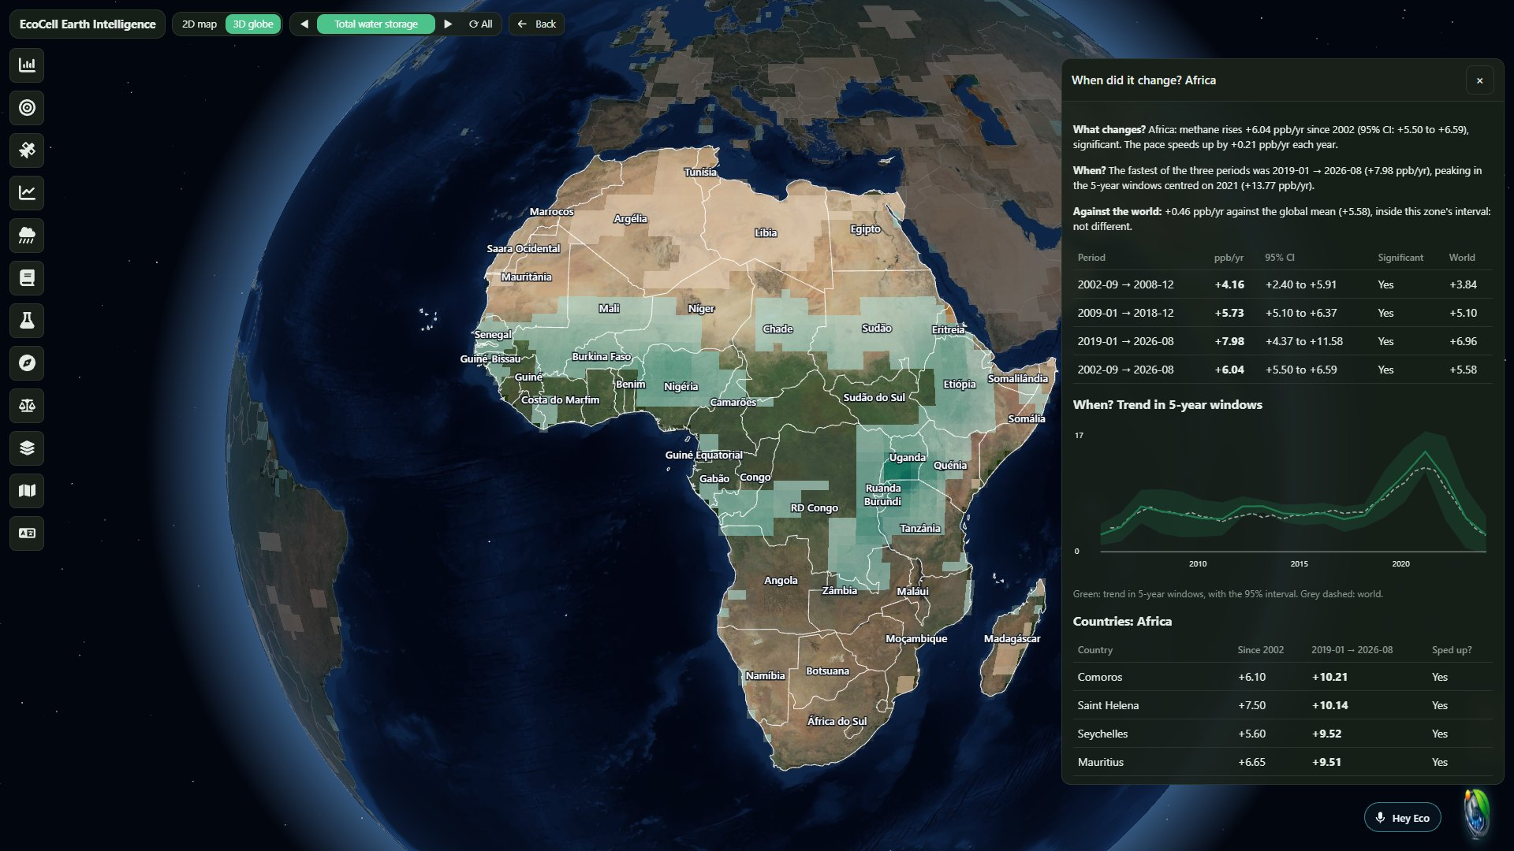
Pick a variable, click a place, get the answer
OUR SOLUTION
1
Choose a NASA variable
Methane, rainfall, vegetation, water, temperature…
2
Click a zone
The world, a continent, a country or one block, on a 2D map or a 3D globe.
3
See when it changed
Trend per period, 95% interval, significance, and the world for comparison.
4
Ask Eco
Say “Hey Eco” and ask in English or Portuguese.
Notes:
This is the user experience. Choose a NASA variable, click any zone, from the whole world down to a single 110-kilometre block, and the panel tells you what changed, how much, when, and whether it is significant, compared with the world. Here we are looking at methane over Africa on the 3D globe.

Slide 4
Built only on NASA open data
NASA DATA
Variable | Mission or model | Years
Methane | Aqua AIRS | 2002–2026
Rainfall | GPM IMERG | 2003–2024
Vegetation (NDVI) | Terra MODIS | 2003–2025
Evapotranspiration | Terra MODIS | 2003–2025
Land temperature | Terra MODIS | 2003–2020
Variable | Mission or model | Years
Water storage | GRACE, GRACE-FO | 2003–2024
Soil moisture | FLDAS model | 2003–2025
Air temperature | FLDAS model | 2003–2025
Ocean temperature | Aqua MODIS | 2003–2025
Ocean chlorophyll | Aqua MODIS | 2003–2025
Updated automatically every night from NASA Earthdata and Google Earth Engine, on NASA Blue Marble imagery.
Notes:
Everything comes from NASA: methane from the AIRS instrument on Aqua, rainfall from GPM, a joint mission with JAXA, vegetation, evapotranspiration and land temperature from MODIS, water storage from GRACE and GRACE Follow-On, soil moisture and air temperature from the FLDAS model, and ocean temperature and chlorophyll from Aqua MODIS. A workflow downloads new data and rebuilds the site every night.

Slide 5
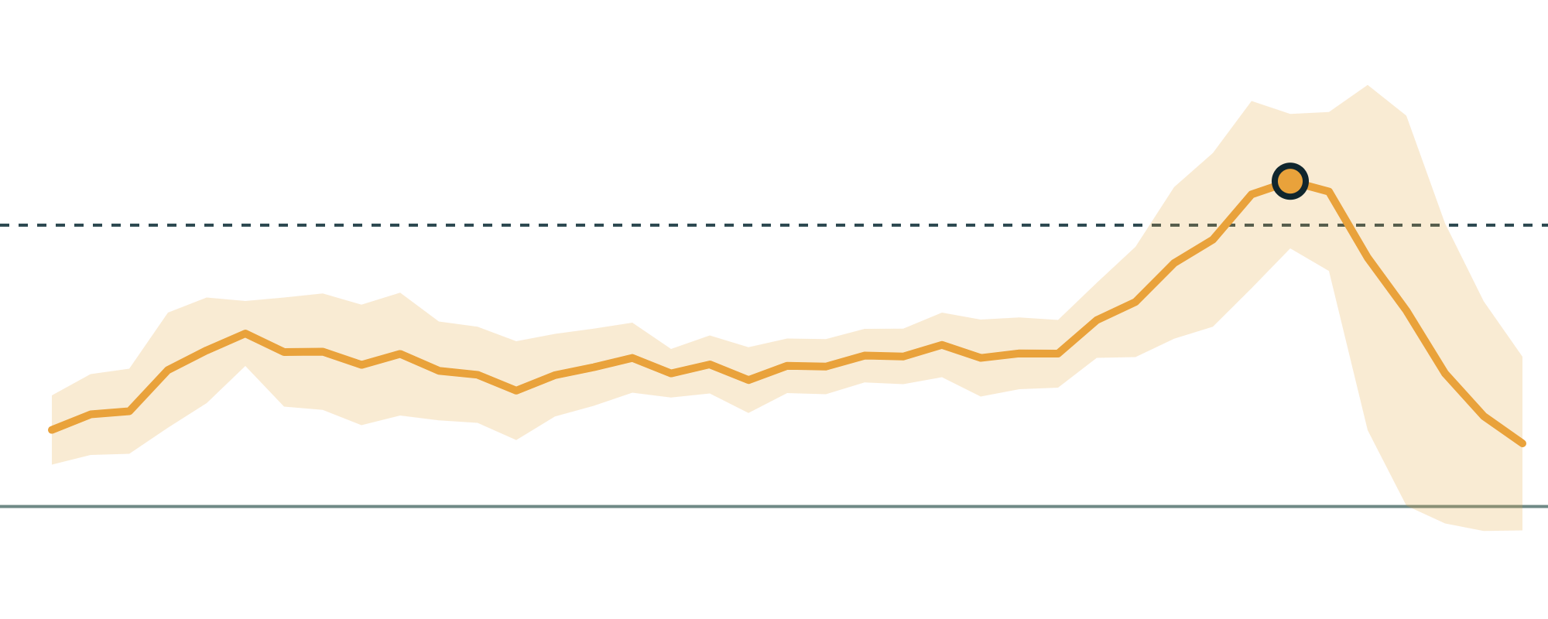
Methane is rising – and speeding up
A RESULT: METHANE, NASA AQUA AIRS
+5.6
Peak ≈ 2021
ppb per year worldwide since 2002 (95% CI +4.9 to +6.2)
+10 ppb/yr
+0.18 ppb/yr each year
the rise is accelerating (95% CI +0.04 to +0.32)
0
Fastest around 2021
2005
2010
2015
2020
about +11.6 ppb/yr in 5-year windows
Global trend in 5-year windows, with the 95% interval shaded. Methods: Sen slope, Mann-Kendall test corrected for autocorrelation, false discovery rate q < 0.05. Regional differences that a second instrument did not confirm are shown only as indicative.
Notes:
One result: global methane measured by NASA’s AIRS instrument rises about 5.6 parts per billion every year since 2002, and the rise is accelerating. Growth was fastest around 2021. Every number on the site comes with its 95% confidence interval, and we label results that a second instrument did not confirm as indicative, so users can trust what they see.

Slide 6
A voice guide, and a path to action
BEYOND THE MAP
ECO, THE VOICE GUIDE
APPLICATION EXAMPLE
Say “Hey Eco”
EcoCell: from methane to clean energy
Map commands run instantly: “zoom to Brazil”, “show rainfall”, “switch to 3D”.
Open questions are answered by AI from the site’s live NASA results.
A guided tour in English and Portuguese.
Methane-eating bacteria in a microbial fuel cell make electricity.
The electricity splits water into hydrogen, then ammonia.
The map shows where to study it; a digital twin explains how it works.
A concept: its performance is not yet validated in the lab.
Notes:
Eco is our voice guide. Say “Hey Eco” and it zooms, switches layers or opens panels instantly, and answers open questions with AI using only the site’s current NASA results. As an application example, EcoCell is a methane-capture concept: methane-eating bacteria in a microbial fuel cell produce electricity, which makes hydrogen and then ammonia. The map shows where it could be studied, and a digital twin explains it. It is still a concept, not yet validated in the lab.

Slide 7
From NASA data to local decisions
IMPACT AND NEXT STEPS
Inform decisions
Find methane sources
Test EcoCell
Show communities and governments where and when their environment changed, with honest uncertainty.
Add NASA EMIT and future methane missions to locate individual emitters.
Build the lab prototype and replace simulated values with measurements.
Try it, free
Open source
albertokialamakuntima-glitch.github.io/ecocell
github.com/albertokialamakuntima-glitch/ecocell
Team [Team name], Angola · Alberto Quiala Makuntima · Augusto Malua · Giovany Ricardo Eduardo Muhonga · Stélvio Manuel de Sousa · Júnior Manuel Olavo Gamboa
Notes:
Next, we want local decision makers to use it to see where and when their environment changed, to add NASA EMIT and future methane missions to find individual sources, and to test the EcoCell prototype in the lab. The site is free and open source. Thank you.

